Slide 1





Controllers and Markup
Controllers, $scope, Markup, Directives, Expressions, Binding, Filters, Validation
SoftUni Team
Technical Trainers
Software University
http://softuni.bg

Slide 2


Table of Contents
Controllers and $scope
Directives
Expressions
Filters
Binding
Validation

Slide 3

Controllers & Scope
Controller
Scope
View

Slide 4
Controllers and Scope
Controller
Contains the presentation logic (e.g. load data)
Responsible for creating the $scope object
$scope object
Communication between controller and view
Holds the data to be displayed by the view
Binding between controller and view can be one-way or two-way
The scope contains the model

Slide 5
Controllers and Scope
Controller
View
Module name
var myApp = angular.module('myApp', []);
myApp.controller('myController',
function myController($scope, /* services */) {
$scope.name = “Angel";
});
Controller name
$scope is injected by Angular
Module to be used
<div ng-app="myApp">
<div ng-controller="myController">
<h1>Hello, {{name}}!</h1>
</div>
</div>
Controller to be used
Everything in $scope is accessed via directives
Hello, Angel!

Slide 6
Constants and Values
Values
Constants
myApp.value('visitors', {
count: 4,
names: ['Nakov', 'Petya', 'Alex', 'Vlado']
});
myApp.constant(‘HOME_SITE', {
'url': 'http://softuni.bg',
'port': 8888
})

Slide 7
Controllers & Scope
Display basic user info
Display collections
Handling events
Live Demo

Slide 8

Directives
DOM Element's Markers

Slide 9
What are Directives?
Angular directives extend the standard HTML functionality
Angular's HTML compiler attaches behaviour to DOM elements
Directives start with ng, e.g. ng-model="article"
Angular directives can be written in several ways:
Like element:
Like attribute:
Like CSS class:
<ng-form />
<div ng-form />
<div class="ng-form" />

Slide 10
Directives: ng-model & ng-change
<input type="text"
ng-change="handleTextboxChange()"
ng-model="textBox" />
Live Demo

Slide 11
Event Directives
Mouse / click events
ngClick
ngDblClick
ngMousedown
ngMouseup
ngMouseenter
ngMouseleave
ngMousemove
ngMouseover

Slide 12
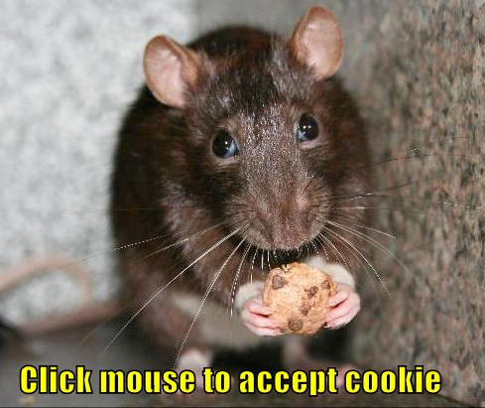
Directives for Mouse Events
Live Demo

Slide 13
Other Directives
ngApp
ngHide
ngClass
ngBind
ngShow
ngClassEven
ngBindTemplate
ngCloak
ngClassOdd
ngBindHtml
ngStyle
ngBindHtmlUnsafe

Slide 14
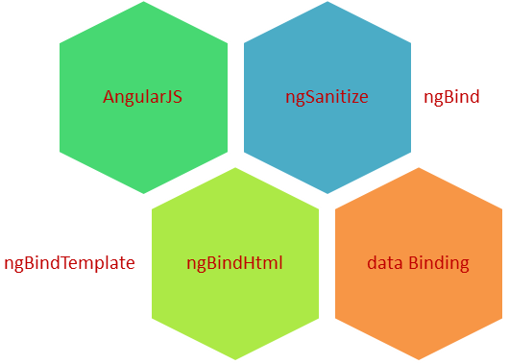
Bind Directives
Live Demo

Slide 15
More Directives
ngDisabled
ngForm
ngChecked
ngSubmit
ngMultiple
ngHref
ngReadonly
ngSrc
ngSelected
ngNonBindable

Slide 16

More Directives
Live Demo

Slide 17


Directives: Old IE Restrictions
Older Internet Explorers (IE) do not support non-HTML tags
What to do for older IE browsers?
Polyfill JSON.stringify()
No NG tags → use attribute or class directives
<ng-pluralize count="…" when="…"></ng-pluralize>
<div ng-pluralize count="…" when="…"></div>

Slide 18
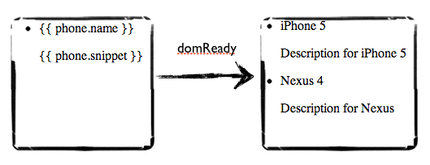

Expressions
Using Expressions in the Views

Slide 19
Expressions
Angular expressions are JS-like code snippets placed in bindings:
Evaluated against the $scope object
Evaluating undefined properties doesn't throw an exception
No control flow statements (e.g. if / else / for)
Can use filters within the expressions
{{ expression }}
<div>3*12={{ 3*12 }}</div> // 3*12=36
<div>{{ person.contacts.email }}</div>

Slide 20
Expressions
Live Demo

Slide 21

Filters
Formatting Data in Expressions

Slide 22
Filters
Angular filters format the value of an expression
Modify the output
Format the output
Sort data
Filter data
Using filters:
{{ expression | filter }}

Slide 23
Built-In Angular Filters
uppercase
lowercase
numbers
currency
date
json
orderBy
limitTo
filter

Slide 24
Writing Custom Filters
Custom filters enable custom formatting / output modifications
module.filter('filter_name', function() {
return function(input, /* filter params */) {
// modify the input
// return modifiedInput;
}
});

Slide 25
Filters
Live Demo

Slide 26
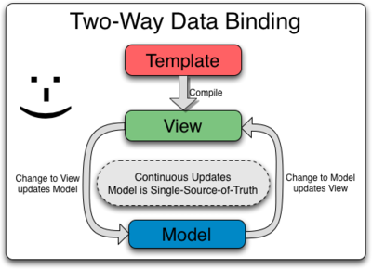
Two-Way Binding
Bind Model Data to the UI Controls

Slide 27

Two-Way Binding
The ngModel directive binds a UI control to Angular model
It works on form input controls:
input
select
textarea
UI Control
Model
<input type="text" ng-model="name" />
<input type="text" ng-model="person.contacts.phone" />

Slide 28

Form Validation
Angular Data Validation Directives

Slide 29
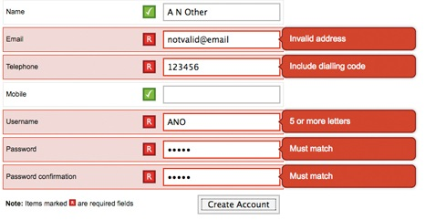
Form Validation
Validation directives
required – makes input field required
ngPattern – validated by regex pattern
Form properties
$valid / $invalid
$dirty / $pristine
CSS classes
You can style ng-classes (ng-dirty, ng-valid, ng-required)

Slide 30
Form Validation
Live Demo

Slide 31


Summary
Can modules depend on other modules?
What is the primary responsibility of the controller?
Can the view bind to functions on the scope?
What are the ways directives can be written?
That is the purpose of the ngCloak directive?
Which bind directive supports multiple bindings?
Do expressions support all JavaScript syntax?
Can you limit a filter to only search in specific field?
Which HTML elements work with two way binding?
SPA with AngularJS

Slide 32









Controllers and Markup
https://softuni.bg/courses/javascript-frameworks

Slide 33
License
This course (slides, examples, demos, videos, homework, etc.) is licensed under the "Creative Commons Attribution-NonCommercial-ShareAlike 4.0 International" license
Attribution: this work may contain portions from
"SPA with AngularJS" course by Telerik Academy under CC-BY-NC-SA license

Slide 34





Free Trainings @ Software University
Software University Foundation – softuni.org
Software University – High-Quality Education, Profession and Job for Software Developers
softuni.bg
Software University @ Facebook
facebook.com/SoftwareUniversity
Software University @ YouTube
youtube.com/SoftwareUniversity
Software University Forums – forum.softuni.bg

